Slide 1

Modeling Structural Uncertainty
Modeling Uncertainty in the Earth Sciences
Jef Caers
Stanford University

Slide 2
Motivation
So far: Earth models and models of uncertainty for properties
So far: methods to represent the Earth as a non-deformable grid with fixed resolution and volumes on regular grid
Many modeling task require modeling the “structure” of the subsurface as a geologically consistent connection between faults and horizons

Slide 3
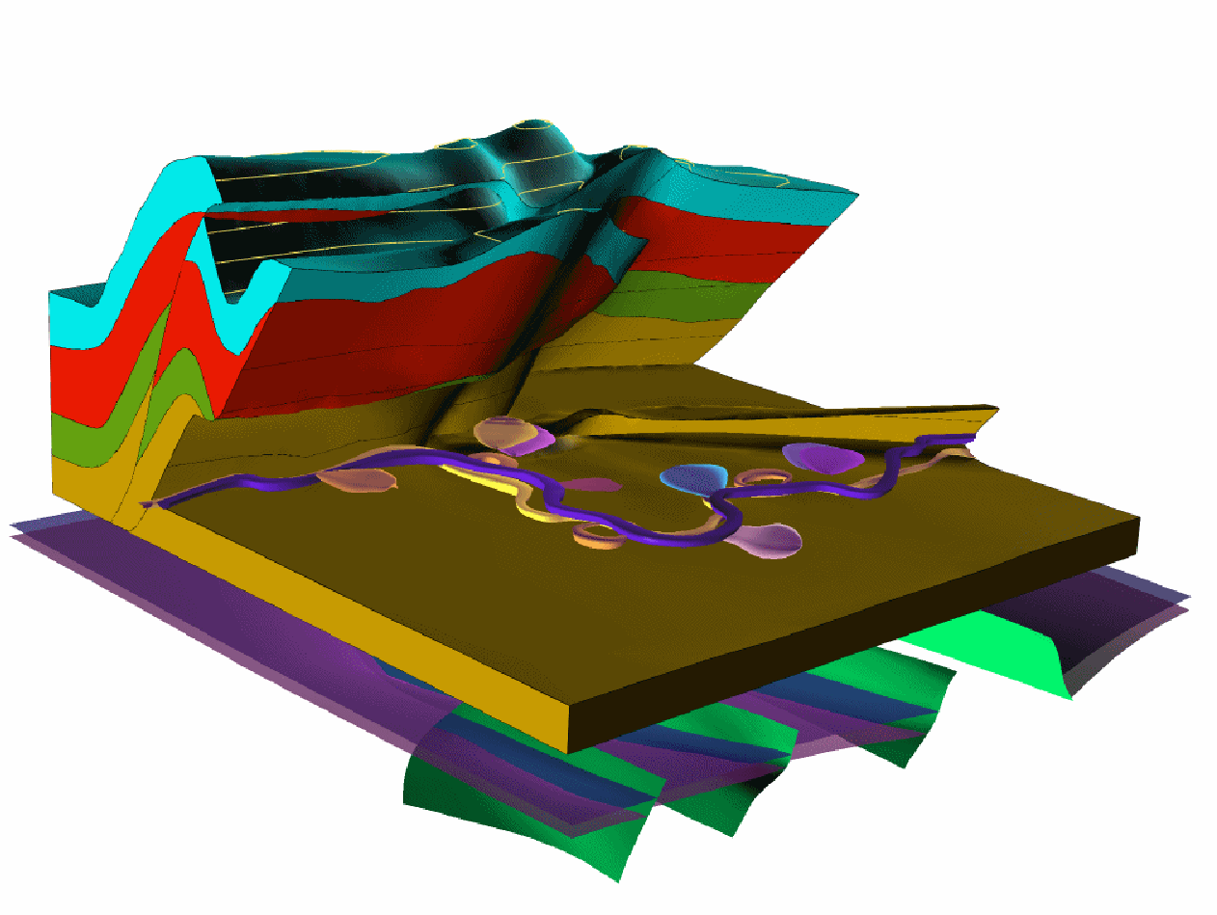
Example

Slide 4
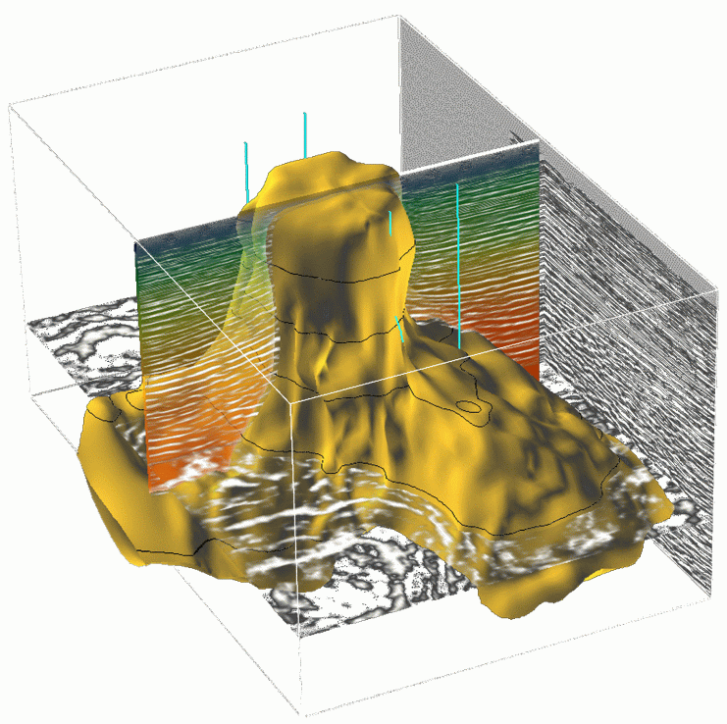
Example: Building a complex salt-dome from seismic

Slide 5
Surface modeling
Modeling structural uncertainty

Slide 6
Data for surface modeling
processing
Most other geophysical/remote sensing methods rely on this principle,
they just rely on different physical equations

Slide 7
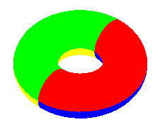
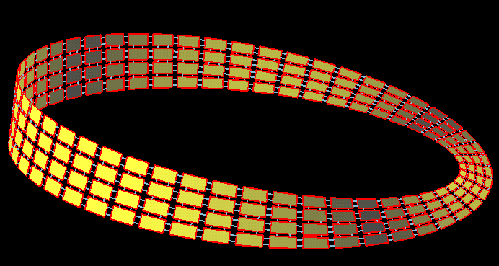
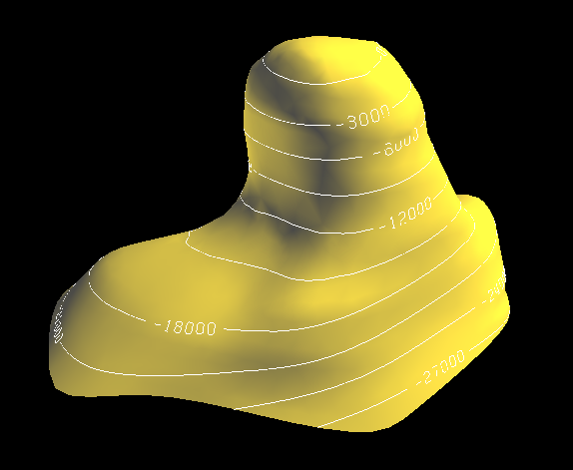
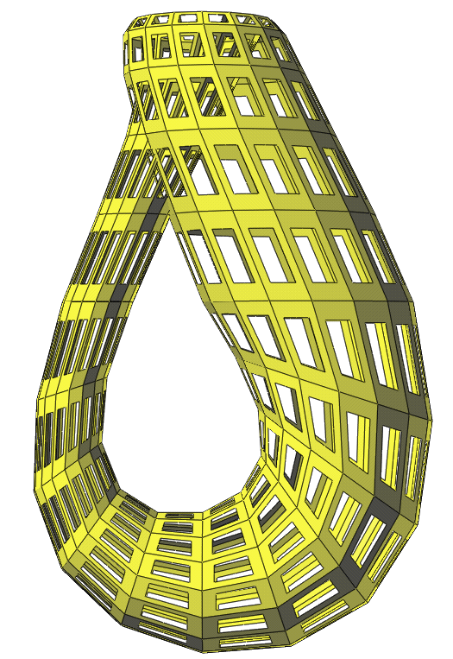
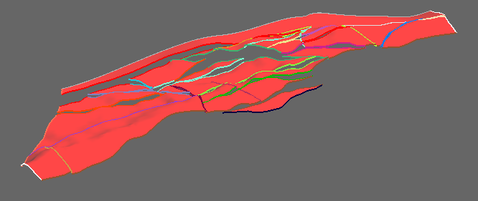
Surface modeling
Torus
Moebius Ring
Salt dome
Faulted horizon
Klein bottle

Slide 8
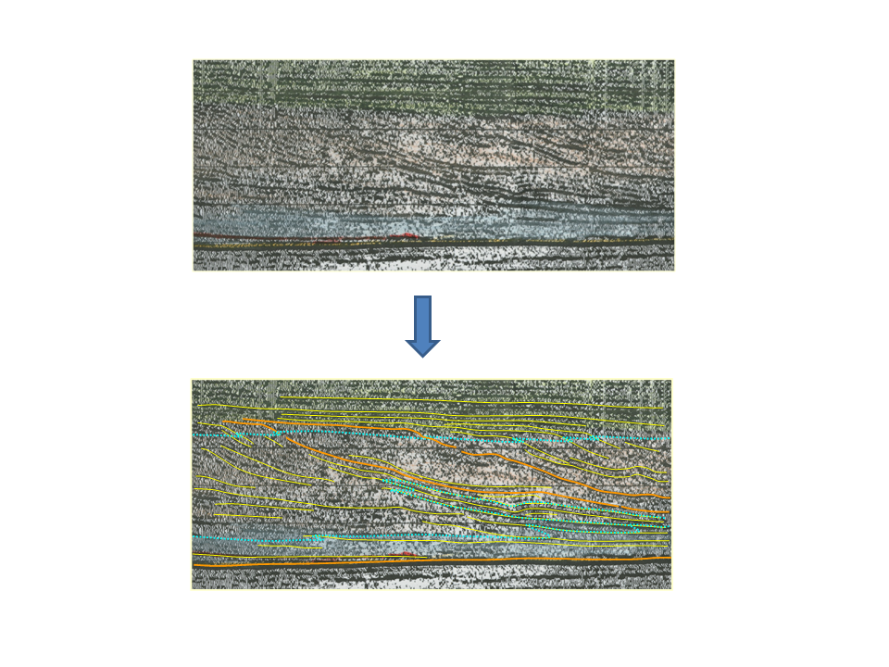
Data for surface modeling

Slide 9
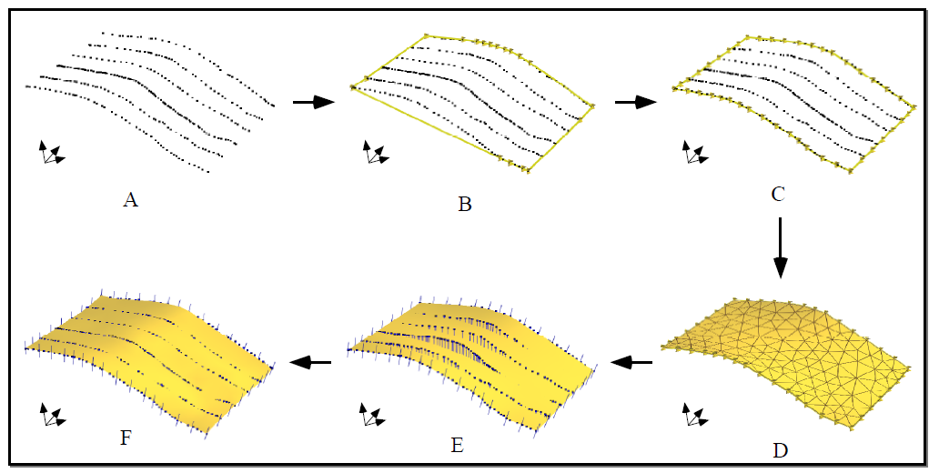
Indirect surface construction
Requires a trade-off between surface smoothness and data fitting

Slide 10
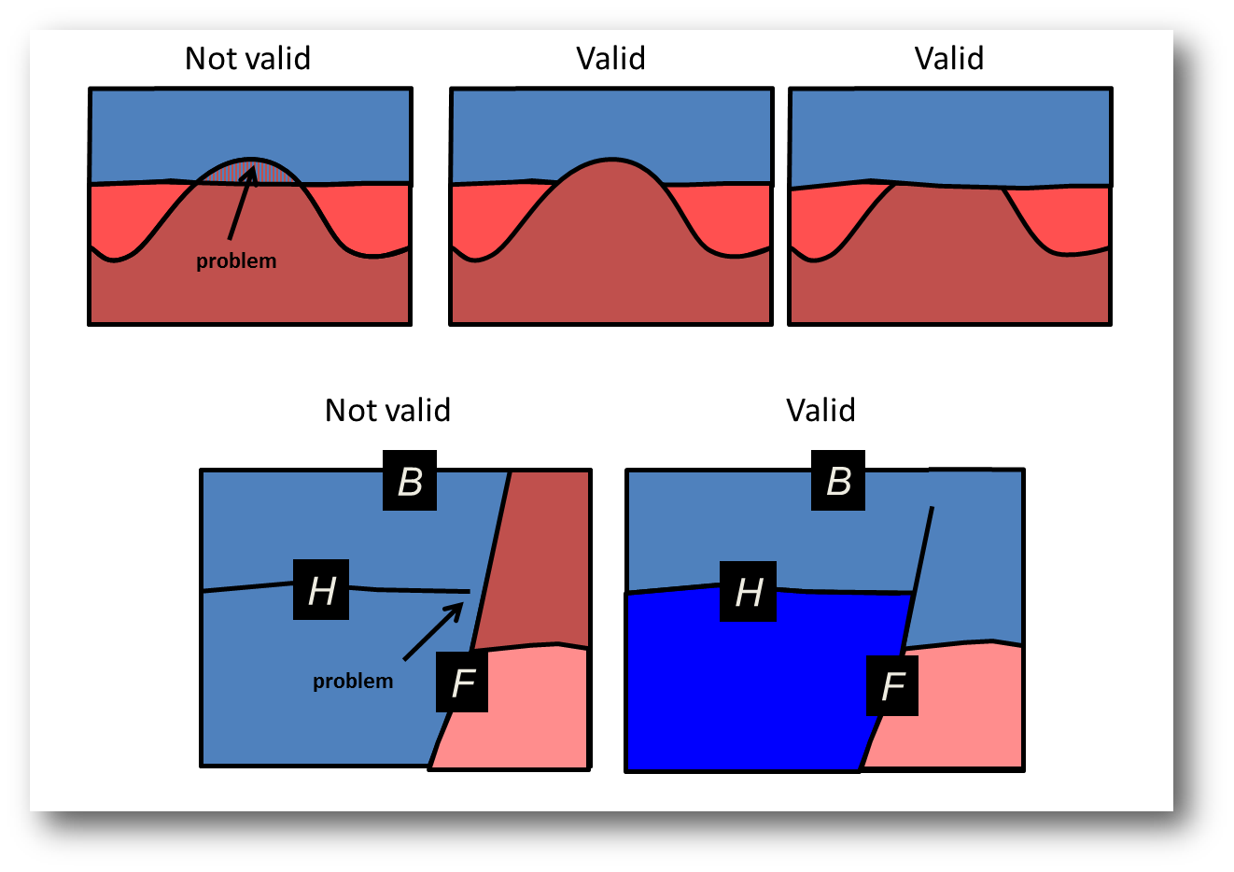
Constructing a structural model consistency checks
Hierarchy is important

Slide 11
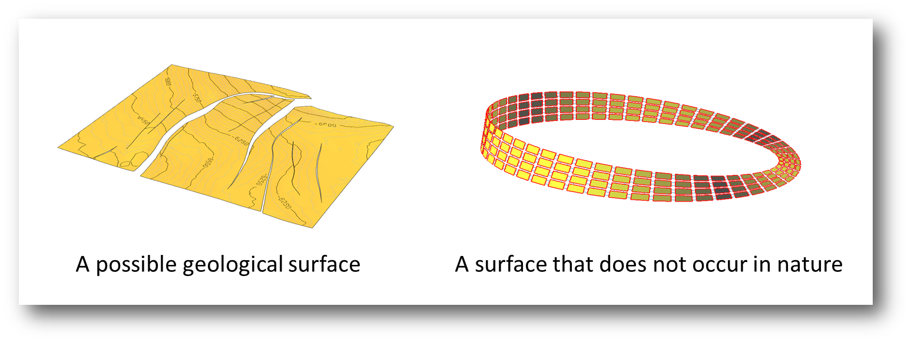
Constructing a structural model consistency checks

Slide 12
Structural modeling
Modeling structural uncertainty

Slide 13
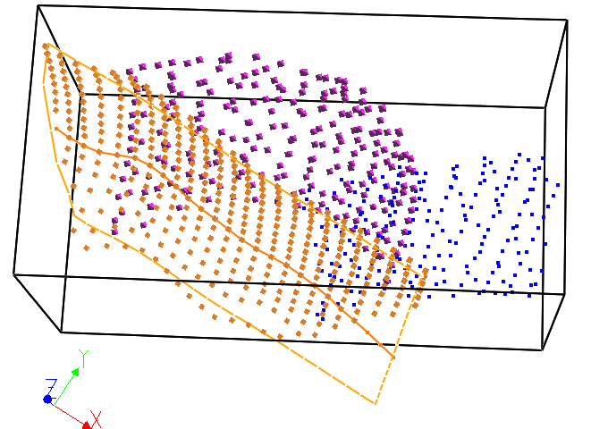
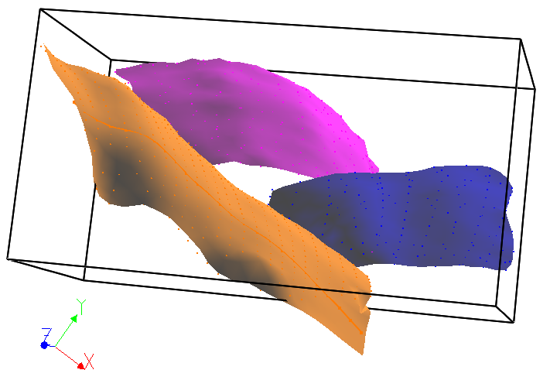
Constructing a structural model
A
B
Interpretation Uncertainty !

Slide 14
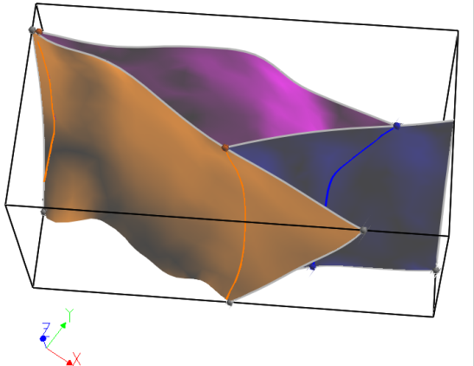
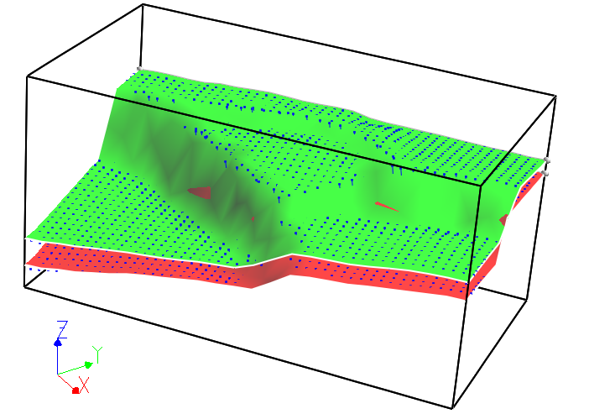
Constructing a structural model
C
D

Slide 15
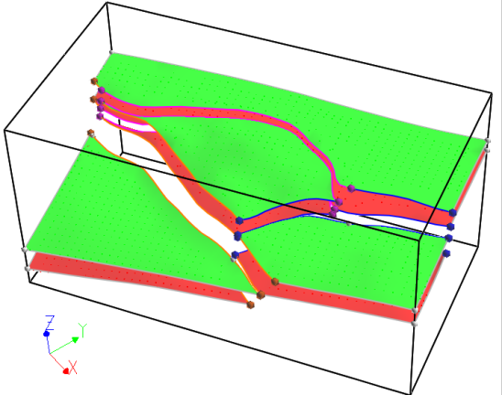
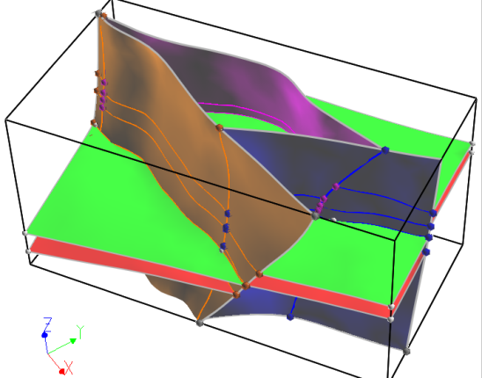
Constructing a structural model
E
F

Slide 16
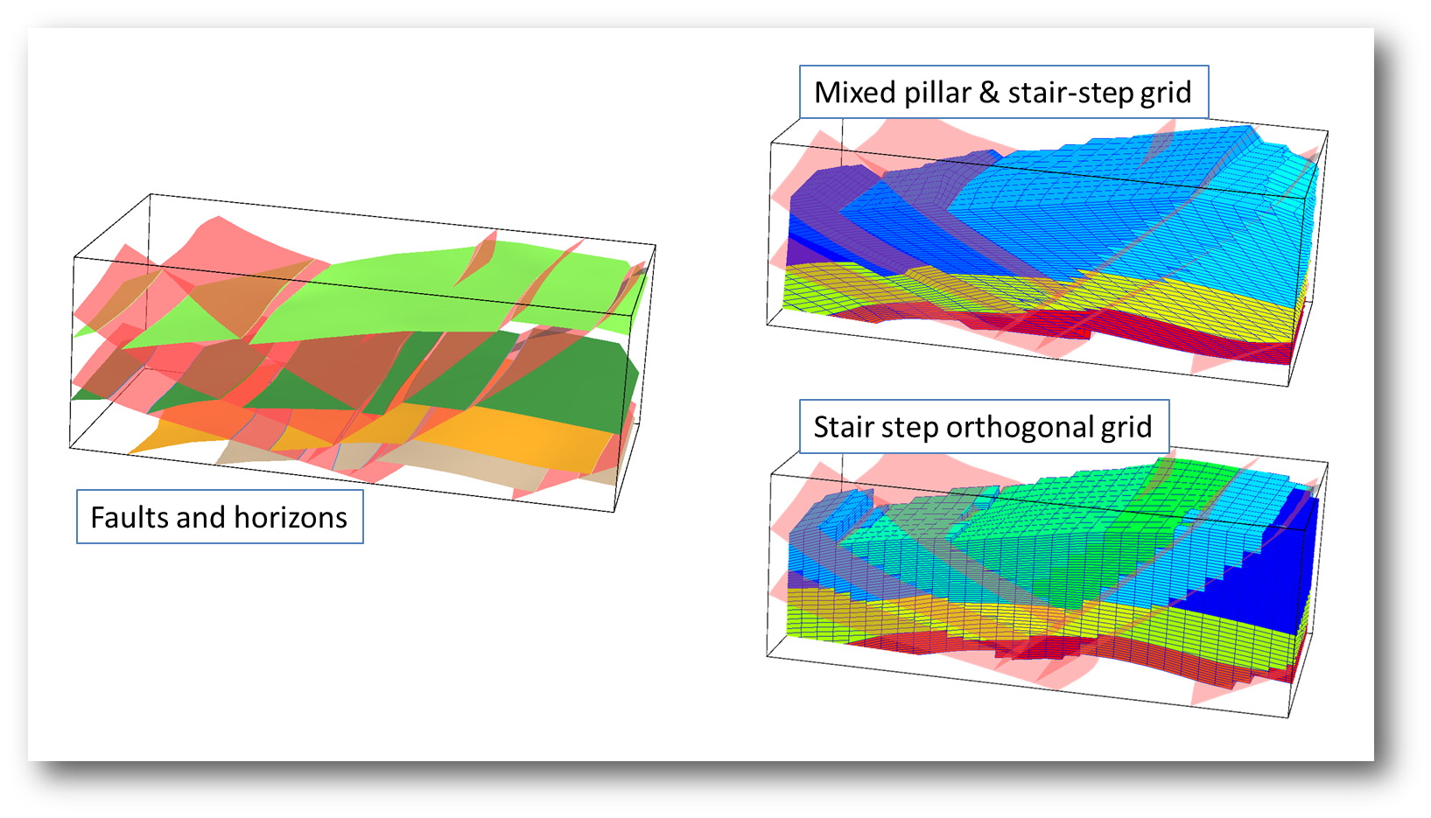
Gridding
Stratigraphic grid

Slide 18
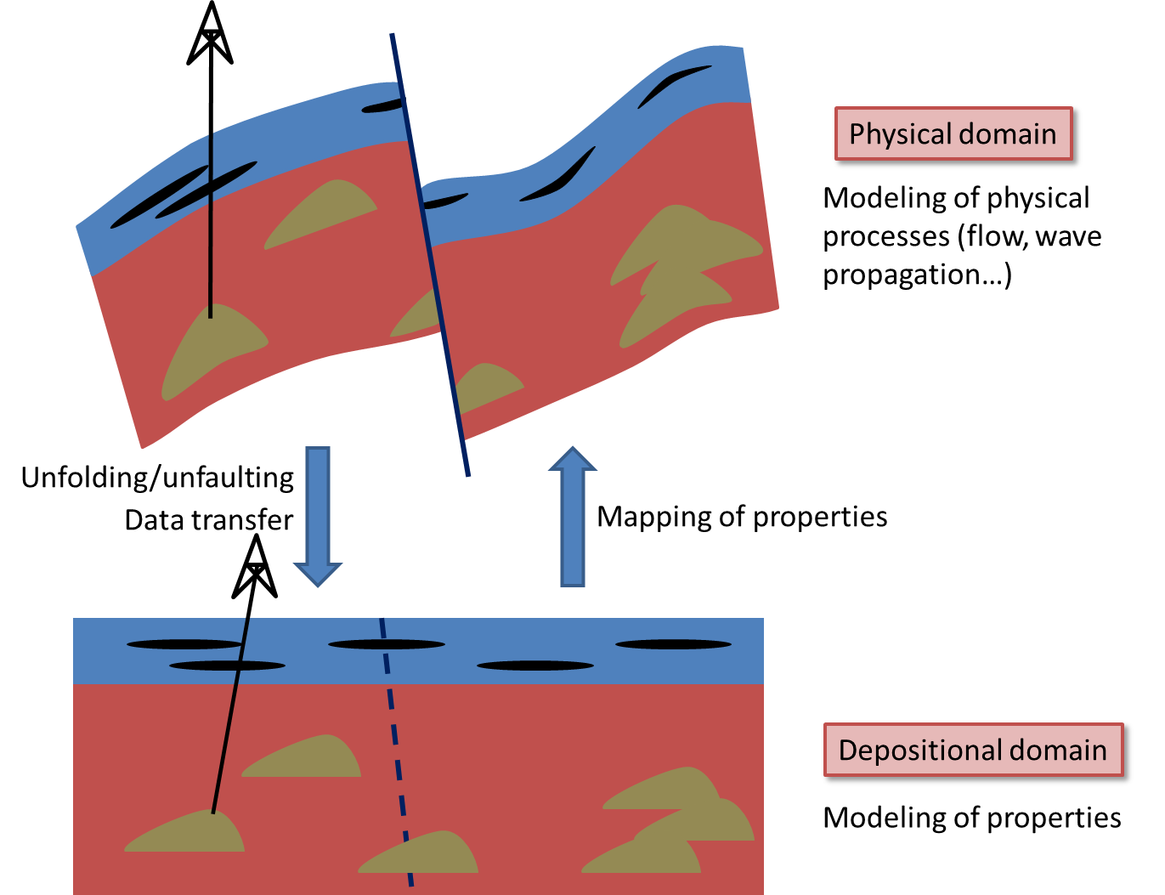
Populating with properties

Slide 19
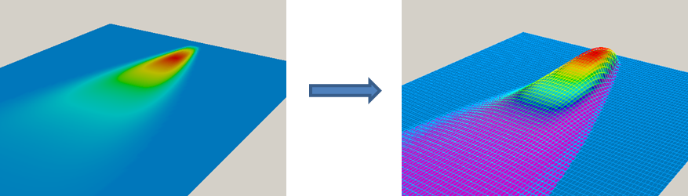
Modeling surfaces with thicknesses

Slide 20
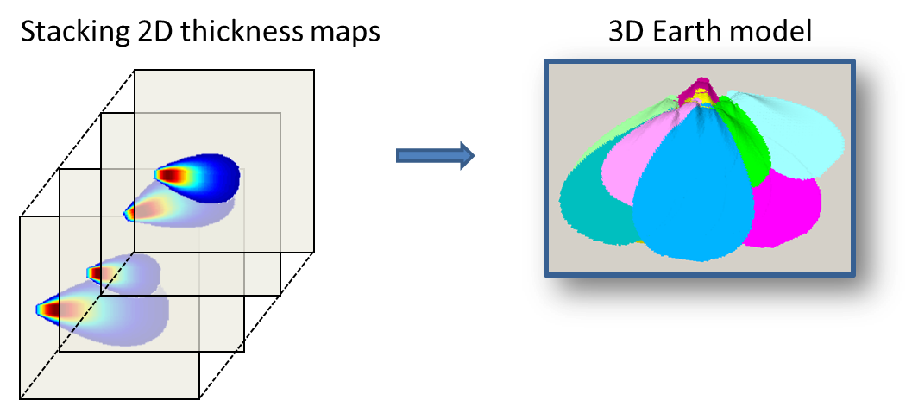
Modeling surfaces with thicknesses

Slide 21
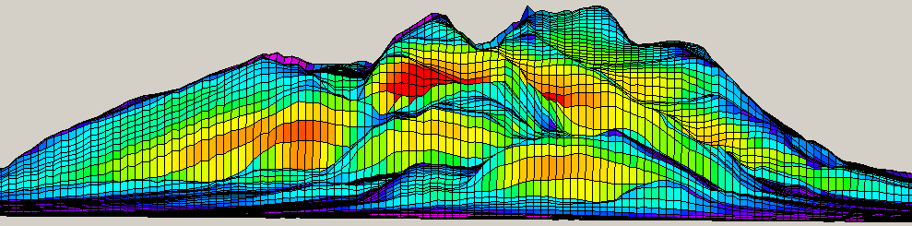
Result

Slide 22
Modeling structural uncertainty
Modeling structural uncertainty

Slide 23
Modeling structural uncertainty
processing
depth
Depth = Velocity x Time
Uncertainty

Slide 24
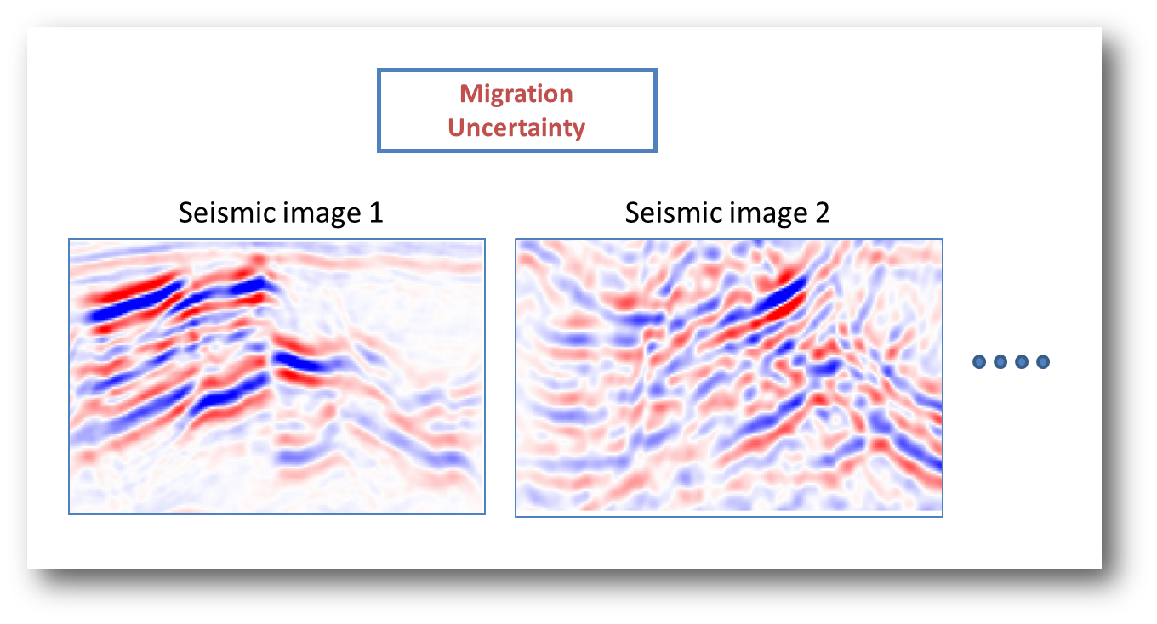
Migration uncertainty

Slide 25
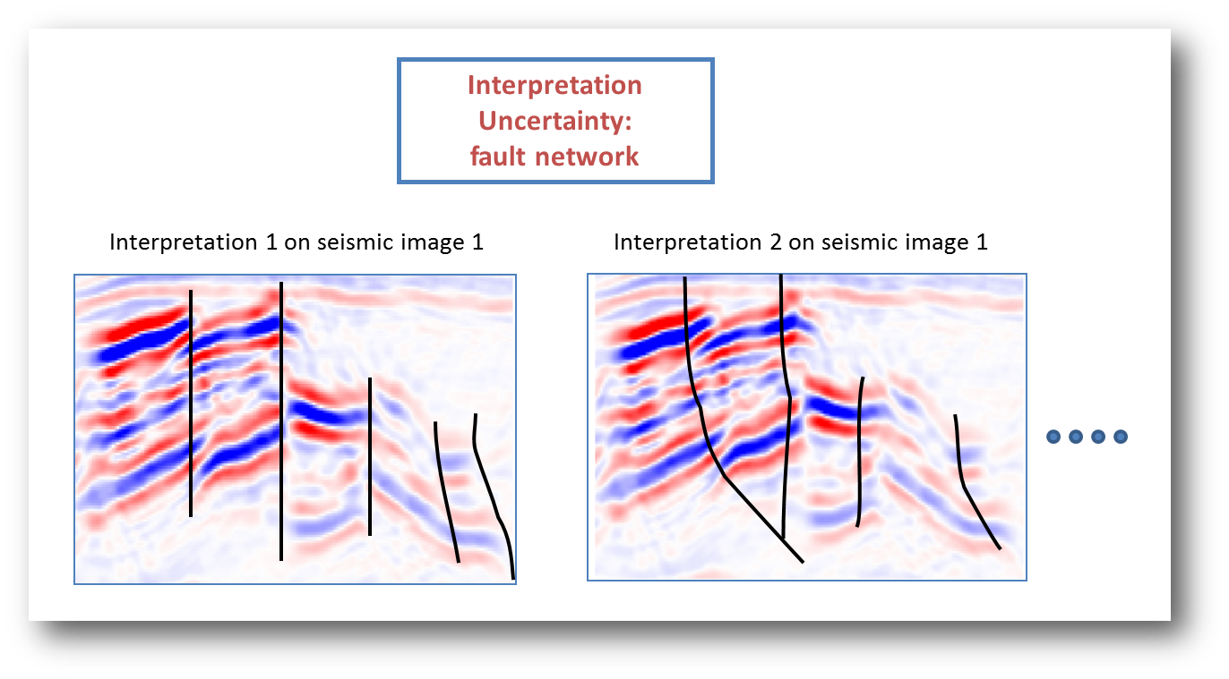
Interpretation uncertainty

Slide 26
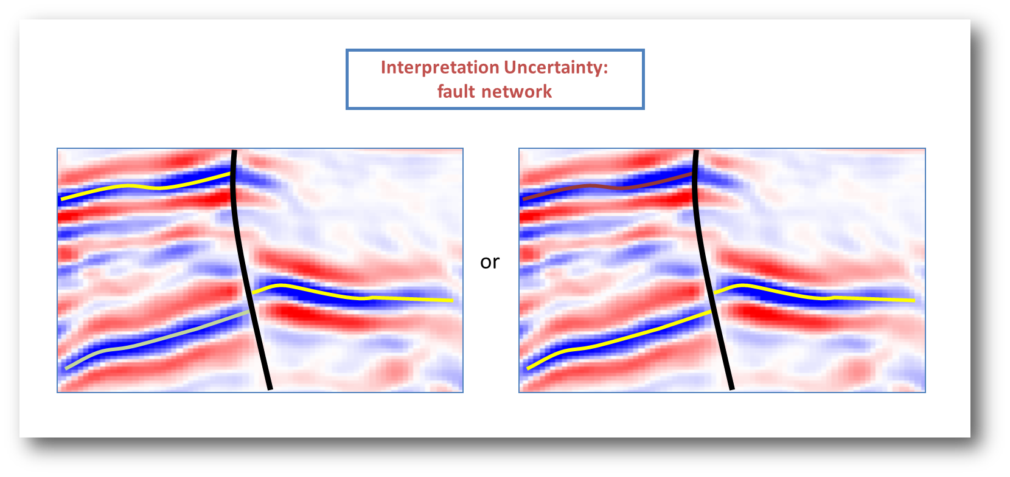
Stratigraphic uncertainty

Slide 27
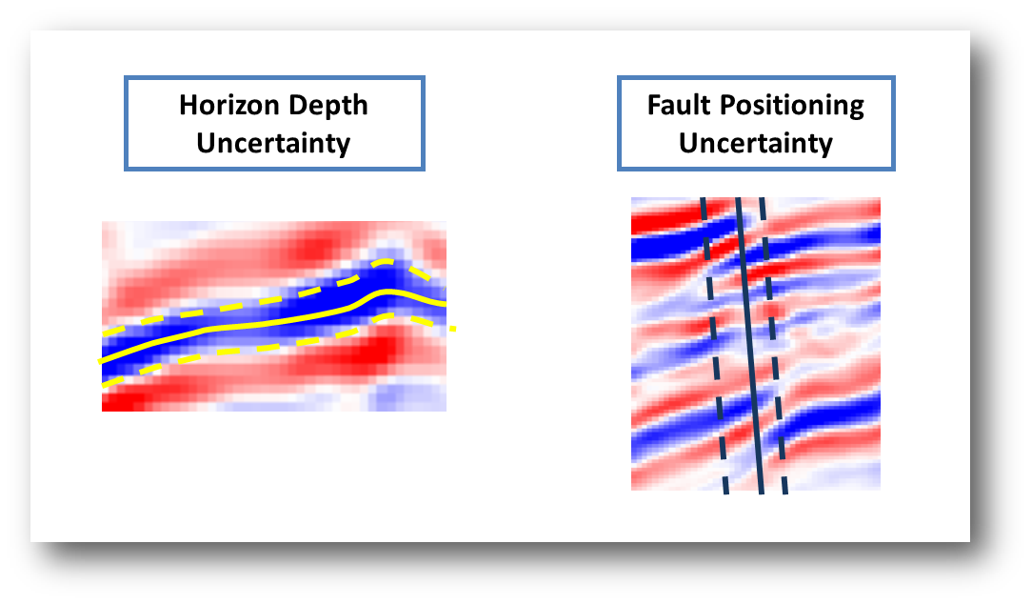
Surface position uncertainty

Slide 28
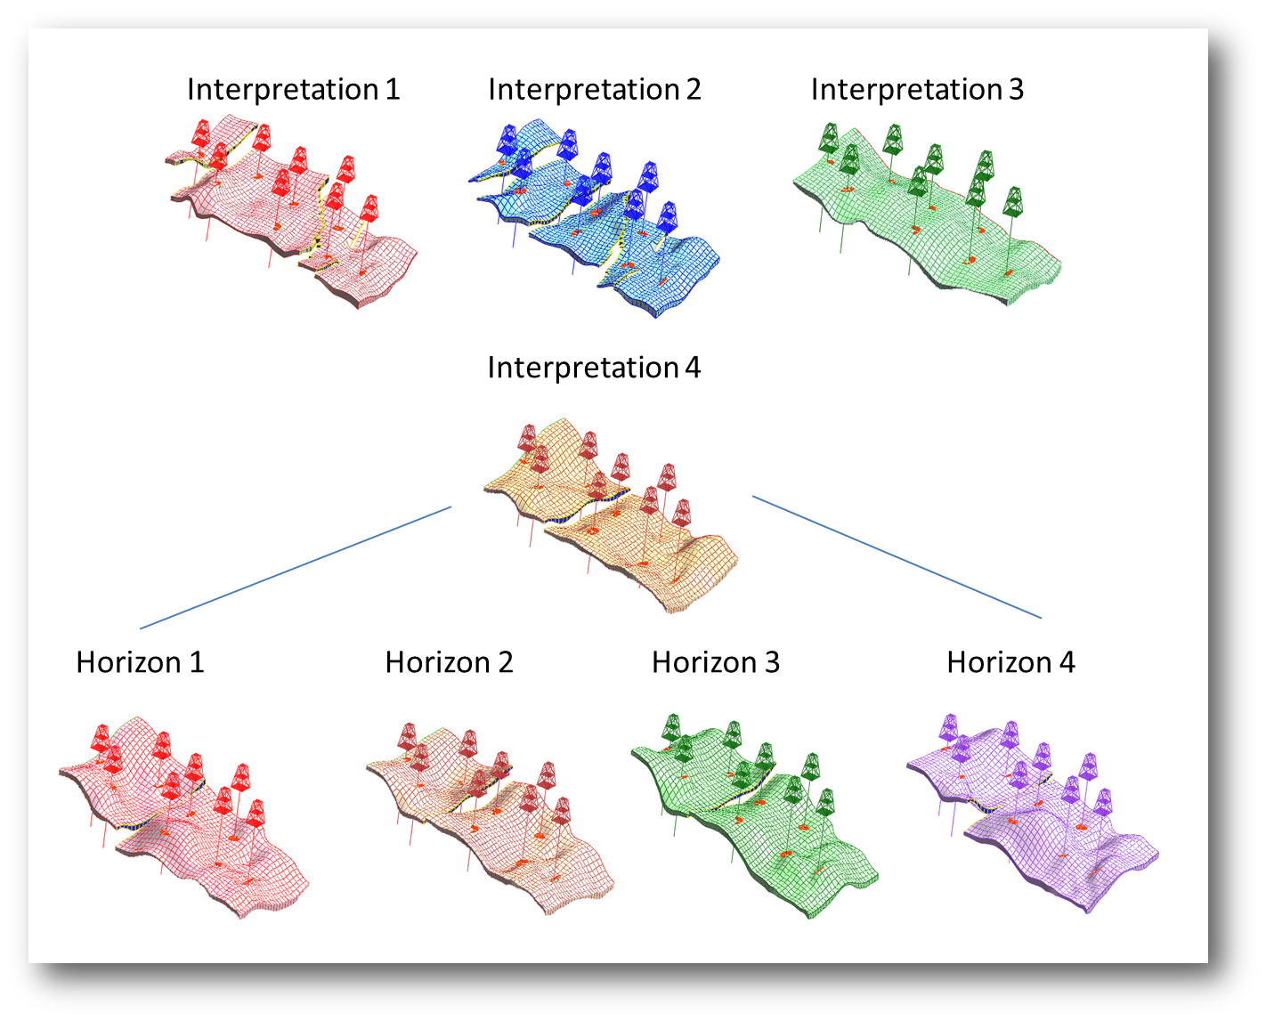
Creating alternative structural models

